Slide 1
The impact of online discussions
Many participants comment on how the opportunity to interact with peers in online discussions contributes to their developing criticality and comfort with Masters level learning. To illustrate how this happens, we have developed ways of visualizing the connections between participants in these non-linear, dynamic discussions. In the examples below, the coloured squares indicate a post to a forum that initiates a discussion. The discs represent posts made in response. Posts made by a particular user are the same colour: you can see how some people contribute to more than one discussion, and some posts kick-start a range of different conversational lines.
Hover over the discussions to see the kinds of things participants say about how the forums contribute to their learning.

Slide 2
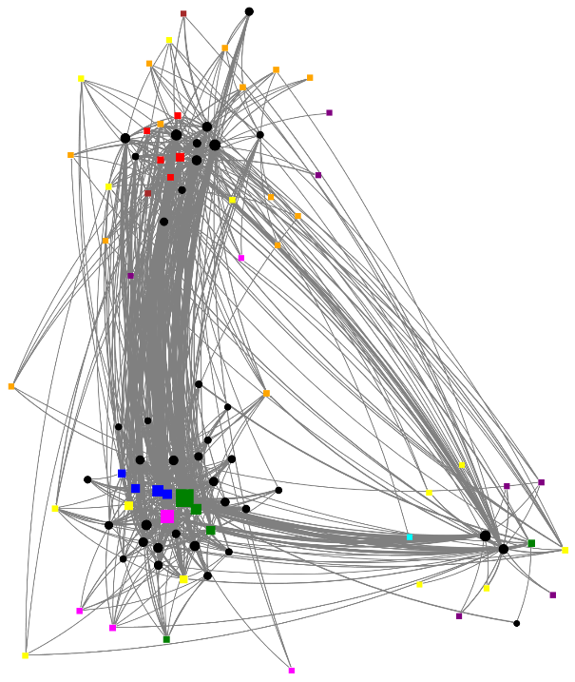
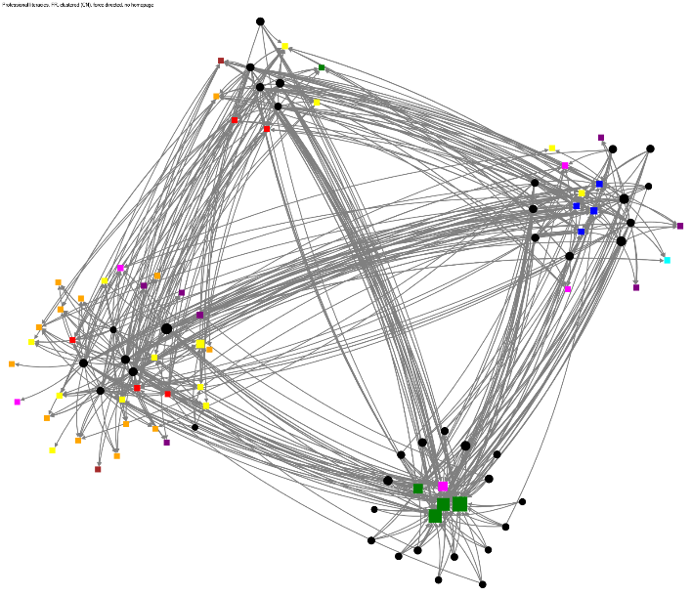
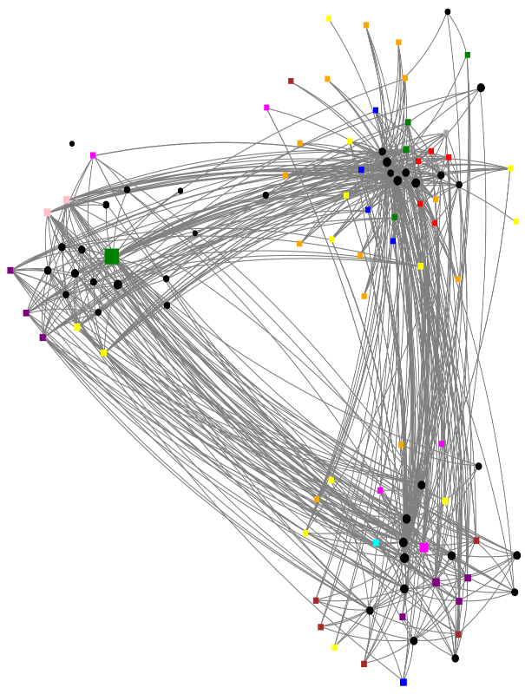
Interacting with online resources
We also developed ways to visualize how different participants approach the module in different ways. The images on this page show participants as black discs and the online resources they connect with as coloured squares. Each image represents a different phase of the module.
You can see how different patterns of resource-use emerge, highlighting the flexibility of the module and how it allows individuals to engage in ways that suit them. Hover over the images to see participants’ comments.

Slide 3
Influencing each other
Participants in one module cohort were given the opportunity to identify other participants who had helped their learning and whom they felt they helped. The images below show these perceived connections..
Whom did I help to learn?
Who helped me to learn?

